Slide 1
Disabled - Friendly Facilities

Slide 2
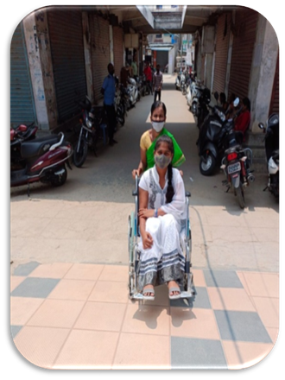
Availability of
Wheel Chair And Slope Ramp

Slide 3
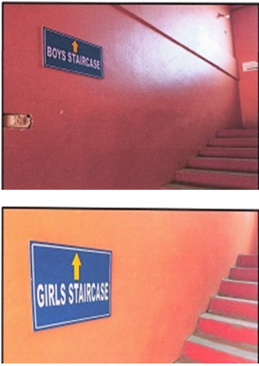
Separate Staircase for Boys & Girls

Slide 4
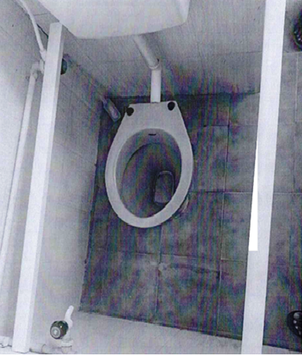
Disabled Friendly Wash Rooms

Slide 5
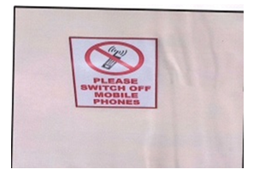
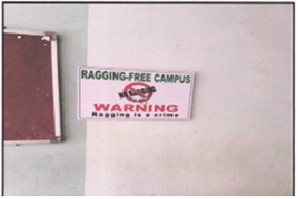
Please Switch Off your Mobile phones
Ragging-Free Zone

